Slide 1
Assessing Emissions from Commercial Motor Vehicle Safety Inspections at Weigh Stations and Port of Entry Facilities
George Noel and Dr. Roger Wayson
107th Air & Waste Management Association Annual Conference and Exhibition
Paper # 33629
June 25th, 2014
The National Transportation Systems Center
U.S. Department of Transportation
Office of the Secretary of Transportation
John A. Volpe National Transportation Systems Center
Advancing transportation innovation for the public good

Slide 2
Overview
Purpose
Data Collected and Site Selection
Data Analysis
Modeling Results
Inspection
CVISN
Findings and Suggestions
Questions

Slide 3
Purpose
2011 Environmental Assessment (EA) for Mexico-domiciled trucks as part of NAFTA pilot program
Conformity analysis conducted at top 6 ports of entry
Office of the Secretary of Transportation (OST) revised analysis based upon Public Citizen Supreme Court Case
Only emissions from Inspections were to be considered
No emissions related data was available regarding inspections
The Teamsters union and Sierra Club challenged the EA
Data collected to support an Environmental Impact Statement (EIS) if were to be required
In April of 2013, the U.S. Court of Appeals ruled against the Teamsters and Sierra Club. They are challenging that appeal.
Notes:
The bullet items listed specify the reason why the study was conducted. The purpose to determine the emissions associated with the safety inspection process.

Slide 4
Inspection Observations
Collect data from weigh station locations in the U.S. interior
Primary - Commercial Vehicle Safety Alliance (CVSA) Inspection data
Idle, Start, Soak time and Drive schedule
Secondary - Commercial Vehicle Information and Networks (CVISN) program
Drive Schedule Data
Queue Times
Collect data from border crossing locations
CVSA Inspection Idle, Start, and Soak times
Other vehicle Activity
Notes:
Primary Task: to collect data directly associated with the inspections
Secondary Task: collect data associated with the CVISN program which can be used to help focus conducting inspections on operators with know safety issues. It also can reduce weigh station times.

Slide 5
Sites Observed
REPORT STATE | MCMIS LOCATION ID | LOCATION Description | ALL INSPECTION LEVELS |  | Level I |  | Level II |  | Level III
 |  |  | Total | Average Time (min) | Total | Average Time (min) | Total | Average Time (min) | Total | Average Time (min)
CA | 651 | SAN ONOFRE IF | 44,538 | 22 | 19,830 | 31 | 115 | 13 | 24,405 | 15
CA | 646 | OTAY MESA IF | 36,706 | 13 | 26,384 | 14 | 4,040 | 12 | 6,145 | 10
MD | 012 | I-95 SOUTHBOUND SCALE FACILITY (Perryville, MD) | 8,158 | 36 | 2,643 | 43 | 4,214 | 35 | 1,291 | 28
OR | 2409 | WOODBURN POE | 7,301 | 35 | 3,066 | 42 | 1,156 | 36 | 2,981 | 29
TX | 3B201 | WORLD TRADE(CUSTOM LOT) | 13,859 | 37 | 7,532 | 47 | 1,874 | 35 | 4,453 | 22
US | 16 | WORLD TRADE BRIDGE | 7,391 | 43 | 5,970 | 45 | 1,063 | 43 | 358 | 16
US | 15 | COLOMBIA BRIDGE | 1,335 | 54 | 886 | 56 | 317 | 56 | 132 | 30
WA | SC72 | RIDGEFIELD (POE) | 10,400 | 29 | 2,947 | 52 | 1,811 | 23 | 5,614 | 18
Notes:
4 Locations are interior U.S. weight stations.
3 Locations were border crossing. Two sites in Laredo,TX and Otay Mesa on the border with Tijuana,MX.

Slide 6
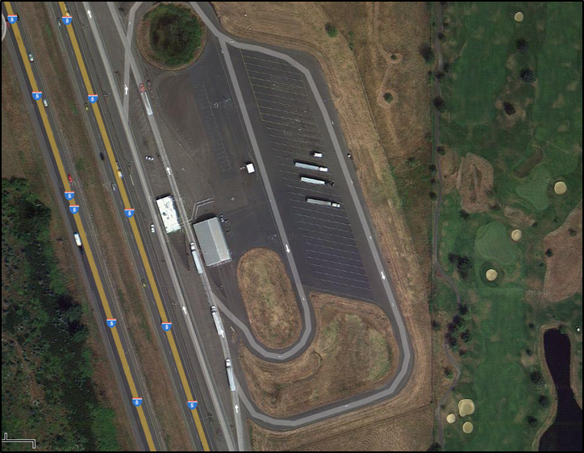
Weigh Station Layout Example - Interior
Ridgefield, WA Site
Notes:
The parking area is the “Out of Service Area” Some of the trucks would idle if there was a safety violation.
The gray roof is the inspection shed.
The white building is the weigh station.

Slide 7
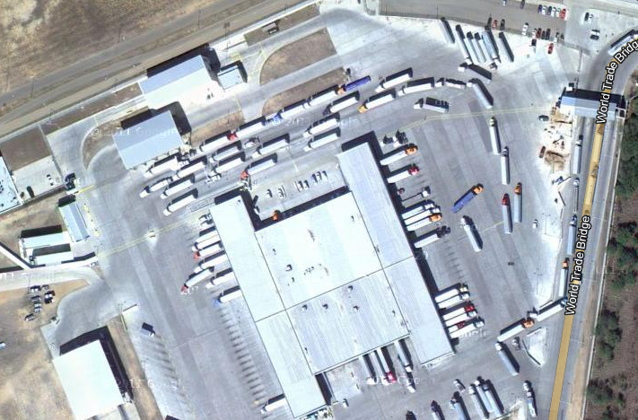
Weigh Station Layout Example - Border
World Trade Bridge Laredo,TX
Notes:
Please explain how the inspection process works at the border crossing. Where we were located was just below the top left corner of the photo.
Explain the other activity that was observed at the border crossing as an interesting note.

Slide 8
Data Collected
Safety Inspection
On/Off Ramp drive schedule
Weigh Station queue drive schedule
Idle, Starts, Soak Time
CVISN Comparison
By-pass drive schedule
Queue drive schedule and times
Other observations
Out of Service (OOS) lot activity
Intra-site Movement

Slide 9
Data Analysis
Inspection Data
Distribution of vehicle idle, soak, and starts by inspection type (I,II,III)
Create on/off-ramp drive schedule for EPA MOVES model
Separate data sets for interior and border locations
CVISN Comparison
Create queue and by-pass drive schedule for EPA MOVES model
Compare queue times be CVISN and non-CVISN sites

Slide 10
Interior Sites
Inspection Level | Level I |  |  | Level II |  |  | Level III
Observations | 563 |  |  | 82 |  |  | 299
Statistics | Average | Median | Std. Deviation | Average | Median | Std. Deviation | Average | Median | Std. Deviation
Idle Time (minutes) | 6.4 | 4 | 8.4 | 11.4 | 5 | 18.7 | 6.5 | 3 | 13.1
Soak (minutes) | 30.4 | 26 | 21.3 | 30.2 | 19 | 35.6 | 22.5 | 16 | 23.9
Starts | 1.5 | 1 | 0.8 | 1.3 | 1 | 0.9 | 1.1 | 1 | 0.6
Notes:
Number of observations per inspection type and the average, median and deviation in values for the interior locations. Idle and Soak are in minutes.

Slide 11
Border Sites
Inspection Level | Level I |  |  | Level II |  |  | Level III
Observations | 860 |  |  | 82 |  |  | 163
Statistics | Average | Median | Std. Deviation | Average | Median | Std. Deviation | Average | Median | Std. Deviation
Idle Time (minutes) | 5.1 | 3 | 5.6 | 4.6 | 3 | 4.0 | 3.2 | 2 | 5.5
Soak (minutes) | 18.6 | 17 | 8.8 | 18.6 | 14 | 14.0 | 14.8 | 12 | 9.2
Starts | 1.6 | 1 | 0.8 | 1.8 | 2 | 0.9 | 1.0 | 1 | 0.3
Notes:
Same as previous slide but for the border locations.

Slide 12
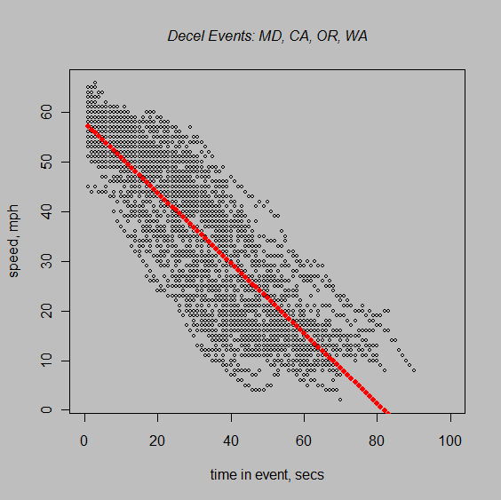
Drive Schedule Results (off-ramp)

Slide 13
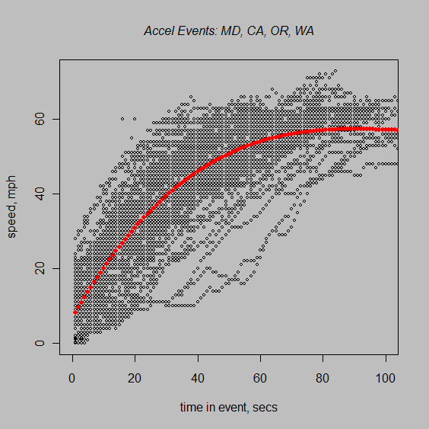
Drive Schedule Results (on-ramp)

Slide 14
Queue Times
Non CVISN Implementation
CVISN Implementation
Notes:
Queue times with CVISIN implemented are much shorter than those without.

Slide 15
MOVES Emissions Rates and Fuel Consumption
Event Type | Emissions Units | HC | VOC | CO | NO_{X} | SO₂ | PM₁₀ | PM_{2.5} | CO₂ | Fuel Consumption (gallons/mile)
On-Ramp | gram/mile | 0.5901 | 0.5849 | 4.19 | 19.952 | 0.0206 | 0.16566 | 0.98209 | 2674 | 0.260
Off-Ramp | gram/mile | 0.6534 | 0.6423 | 2.49 | 2.987 | 0.0036 | 0.04711 | 0.37255 | 472 | 0.046
By-Pass/Highway free flow (56 mph) | gram/mile | 0.4781 | 0.4750 | 2.62 | 13.660 | 0.0128 | 0.07289 | 0.43463 | 1660 | 0.161
Intra-Site Movement to Inspection (15 mph) | gram/mile | 1.1937 | 1.1672 | 4.52 | 16.690 | 0.0158 | 0.11959 | 0.71273 | 2045 | 0.199
Intra-Site Movement from Inspection (17 mph) | gram/mile | 1.0533 | 1.0299 | 3.99 | 14.726 | 0.0139 | 0.10552 | 0.62888 | 1805 | 0.175
Idle/Queue | gram/hour | 9.6418 | 9.5726 | 22.94 | 77.368 | 0.0605 | 4.45680 | 4.32323 | 7856 | 0.764
Start | gram/start | 0.2327 | 0.1849 | 3.30 | 0.772 | 0.0000 | 0.00069 | 0.00067 | N/A | N/A
Notes:
This table shows the emissions and fuel consumption rates association with each event that occurs during the inspection process.
The “Event Type” is one emissions component of the entire inspection process.

Slide 16
Inspection Emissions and Fuel Consumption
Inspection Type/Location | HC (grams) | VOC (grams) | CO (grams) | NO_{X} (grams) | SO₂ (grams) | PM₁₀ (grams) | PM_{2.5} (grams) | CO₂ (grams) | Fuel Consumption (gallons)
Interior Level I (No CVISN) | 3.6626 | 3.5534 | 17.14 | 45.56 | 0.0421 | 1.0508 | 2.3713 | 5461 | 0.531
Interior Level I (CVISN) | 3.2159 | 3.1099 | 16.08 | 41.98 | 0.0393 | 0.8443 | 2.1710 | 5097 | 0.496
Interior Level II (No CVISN) | 4.4195 | 4.3142 | 18.40 | 51.85 | 0.0471 | 1.4221 | 2.7314 | 6116 | 0.595
Interior Level II (CVISN) | 3.9728 | 3.8706 | 17.33 | 48.27 | 0.0443 | 1.2156 | 2.5311 | 5752 | 0.559
Interior Level III (No CVISN) | 3.5856 | 3.4954 | 15.86 | 45.38 | 0.0422 | 1.0580 | 2.3782 | 5474 | 0.532
Interior Level III (CVISN) | 3.1388 | 3.0519 | 14.80 | 41.80 | 0.0394 | 0.8515 | 2.1779 | 5110 | 0.497
Border Level I | 1.1918 | 1.1094 | 7.23 | 7.81 | 0.0051 | 0.3799 | 0.3685 | 668 | 0.065
Border Level II | 1.1580 | 1.0666 | 7.70 | 7.32 | 0.0046 | 0.3429 | 0.3327 | 602 | 0.059
Border Level III | 0.7469 | 0.6954 | 4.52 | 4.90 | 0.0032 | 0.2384 | 0.2312 | 419 | 0.041
Notes:
There are the total emissions and fuel consumed per inspection for each inspection type.
There were 3 different levels of inspection that we observed.
With CVISN means there are lower queue times while going through the weight station.
Mention that there are over 3 million of these inspections every year across the country.

Slide 17
CVISN Emissions, Fuel Consumption, and Time
Emissions, Fuel Consumption and Time Savings
By-Pass Savings (per By-Pass) | HC (grams) | VOC (grams) | CO (grams) | NO_{X} (grams) | SO₂ (grams) | PM₁₀ (grams) | PM_{2.5} (grams) | CO₂ (grams) | Fuel Consumption (gallons) | Time (minutes)
CVISN By-Pass | 0.4627 | 0.4539 | 2.11 | 1.56 | 0.0037 | 0.1879 | 0.6358 | 483 | 0.047 | 2.458
No CVISN By-Pass | 0.9095 | 0.8974 | 3.17 | 5.15 | 0.0065 | 0.3944 | 0.8361 | 847 | 0.082 | 5.238
Notes:
This table shows how much a by-pass of the weigh station facility saves in emissions, fuel, and time.
The CVISN by-pass saves less time than have no CVISN because the CVISN creates lower queue times.
By-passing a faciltiy that does not have CVISN implemented with save more emissions, time, and fuel.

Slide 18
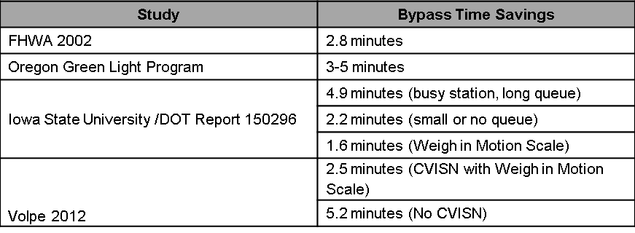
How can this data be used?
Environmental Analysis (i.e., EA or EIS)
Benefits of CVISN
Time Savings
Fuel Savings
Determine ways to further reduce emissions and fuel consumption during and after inspections
Notes:
Volpe’s Findings were in line with other studies on this topic. We are the only one to look at the emissions aspect.

Slide 19
Questions?

